Slide 1
Cross-site scripting (XSS) attack
https://owasp.org/www-community/attacks/xss/

Slide 2
Overview
What is XSS
Discover XSS
Hooking vulnerable-page visitors to BeEF

Slide 3
What is XSS

Slide 4
XSS
A type of injection attack
Attacker injects malicious scripts into otherwise benign and trusted websites.
Whenever (any) victim visits injected Web site
Malicious instructions are sent to victim’s browser

Slide 5
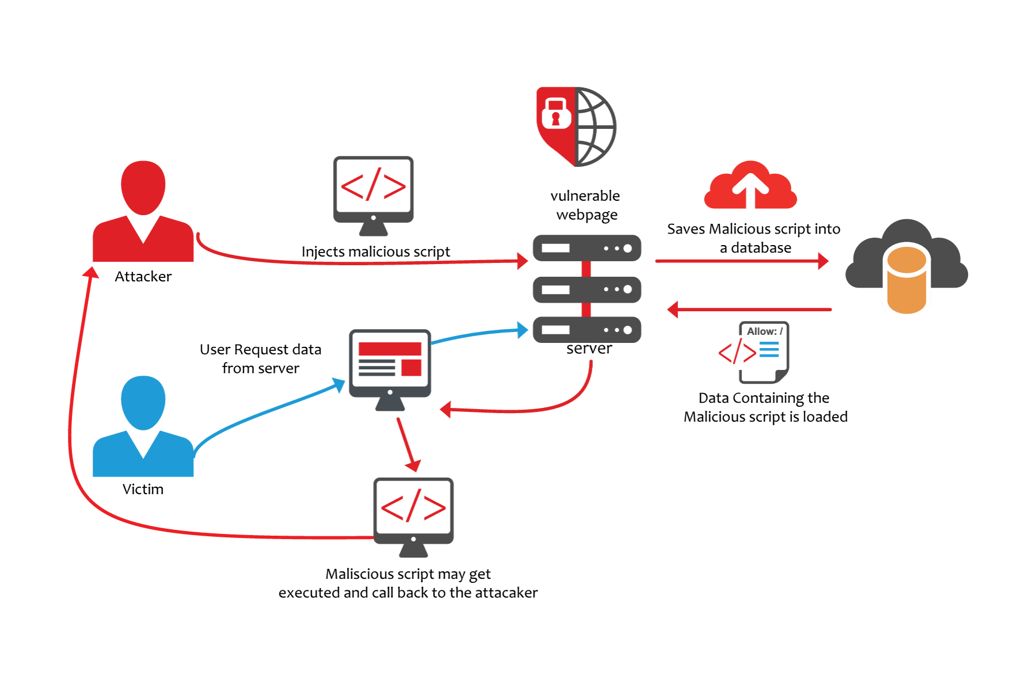

Slide 6
Discover XSS

Slide 7
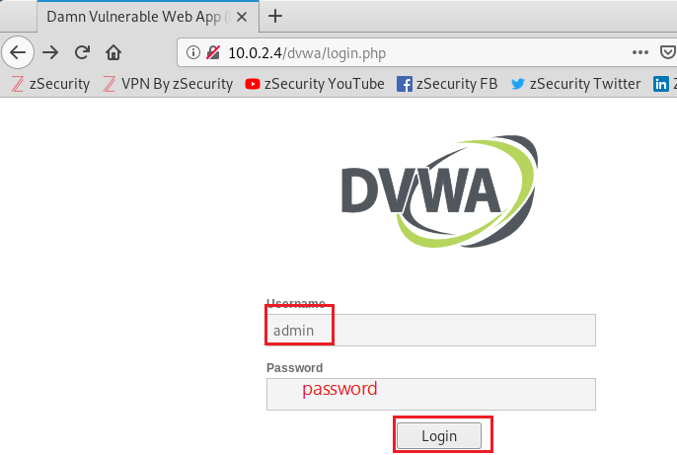
Damn Vulnerable Web App (DVWA)

Slide 8
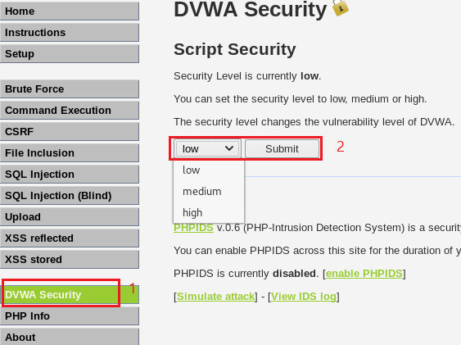
Set script security to low

Slide 9
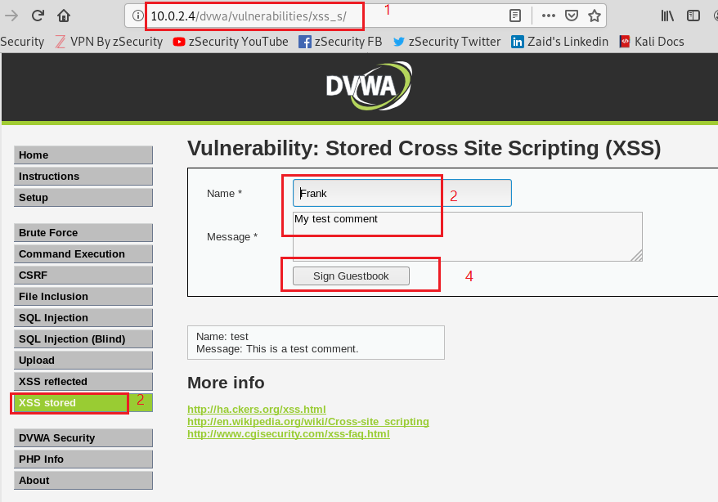
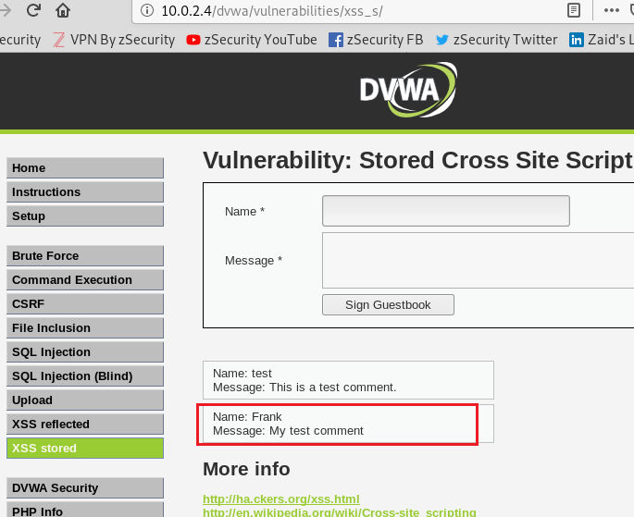
Test normal post message function

Slide 10
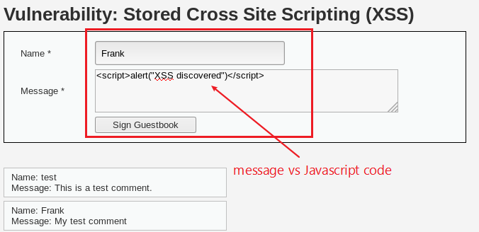
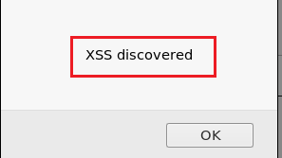
Discover XSS using Javascript alert function

Slide 11
Hooking vulnerable-page visitors to BeEF

Slide 12
What is BeEF
Browser Exploitation Framework.
It is a penetration testing tool that focuses on the web browser.
Inject JavaScript code to vulnerable pages (at web server)
Run JavaScript code at victims’ PC
Control victims’ PC from BeEF

Slide 13
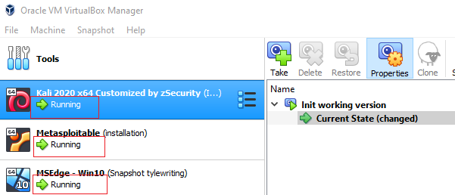
Start all three VMs
 | Username | Password
Kali | root | toor
Metasploitable | msfadmin | msfadmin
Win 10 |  | Passw0rd!

Slide 14
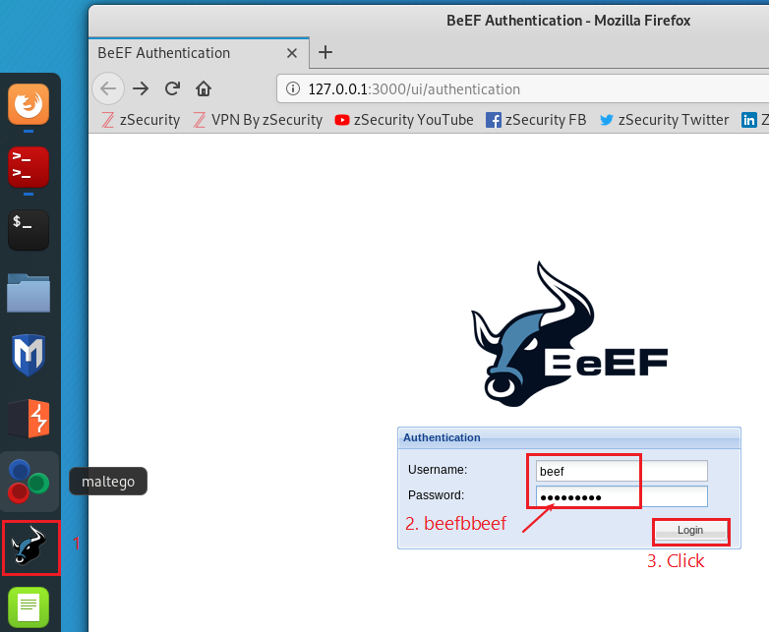
BeEF login
For Kali 2019:
Username: beef
Password: beef
If you want to change password
leafpad /etc/beef-xss/config.yaml

Slide 15
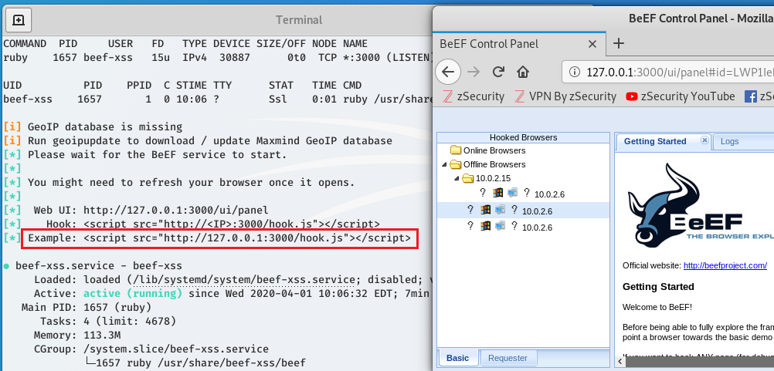
Script to hook victim’s PC

Slide 16
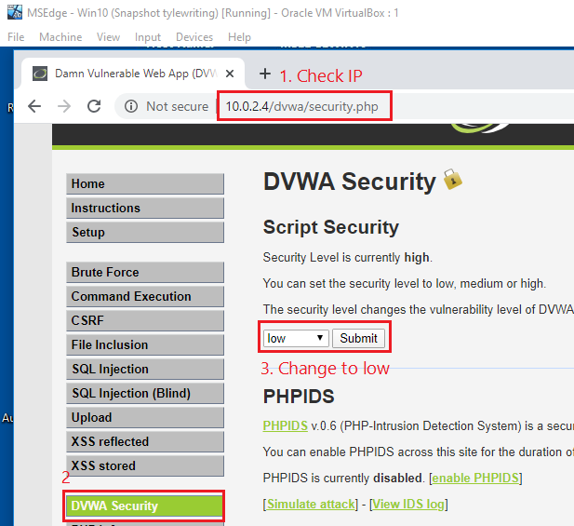
Kali PC: Change security setting to low

Slide 17
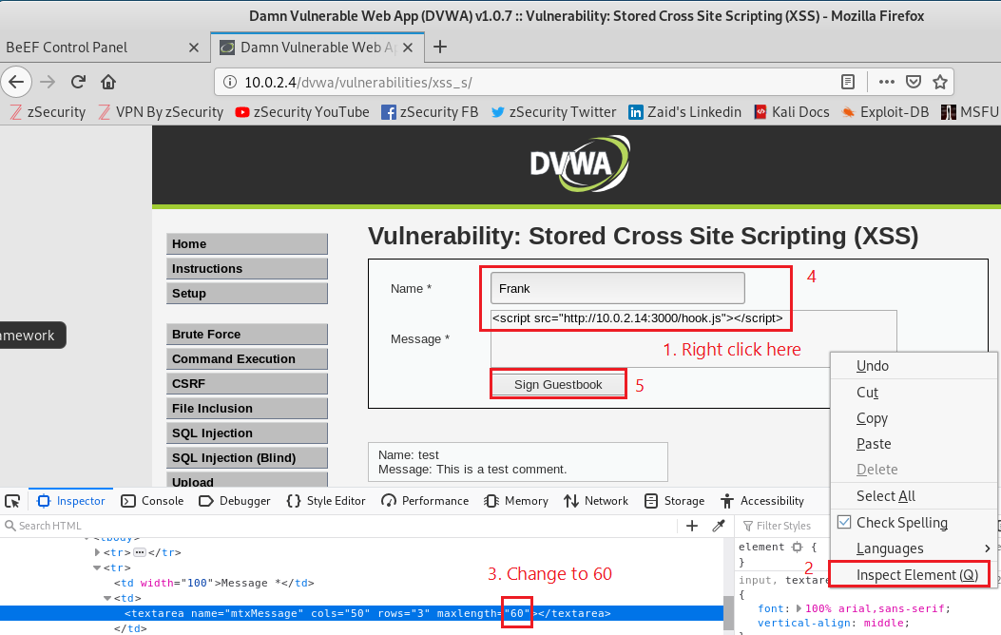
Kali Machine

Slide 18
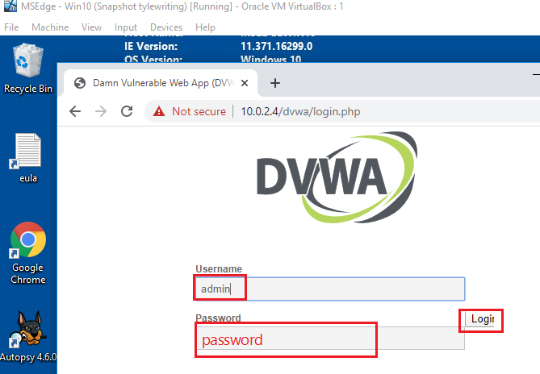
Victim’s PC
Make sure use Metasploit ID

Slide 19
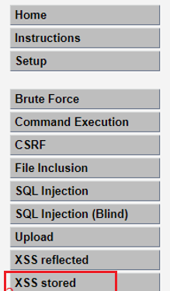
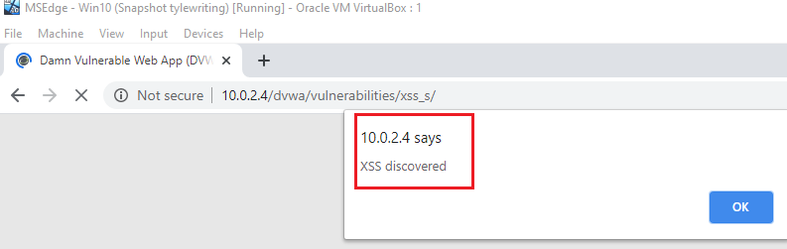
Victim’s PC

Slide 20
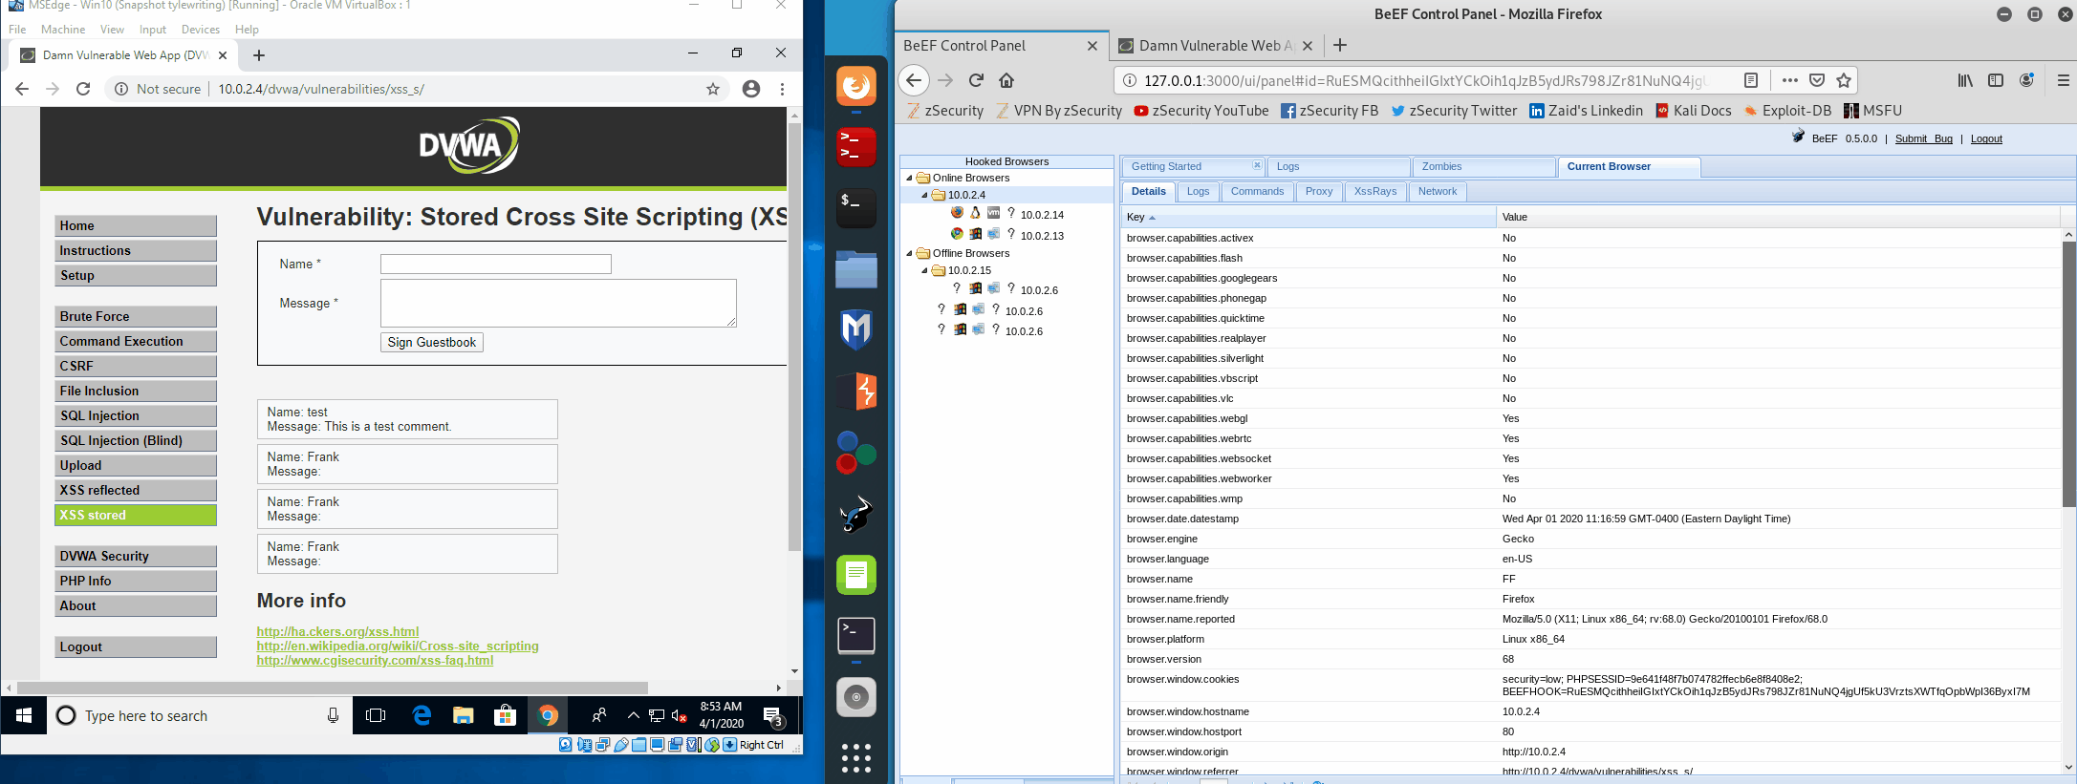
Animation – Send an Alert to victim

Slide 21
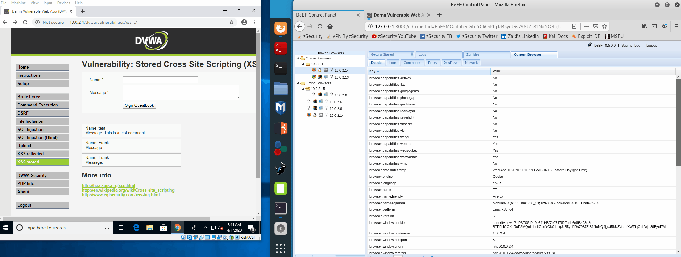
Animation- Send fake updates

Slide 22
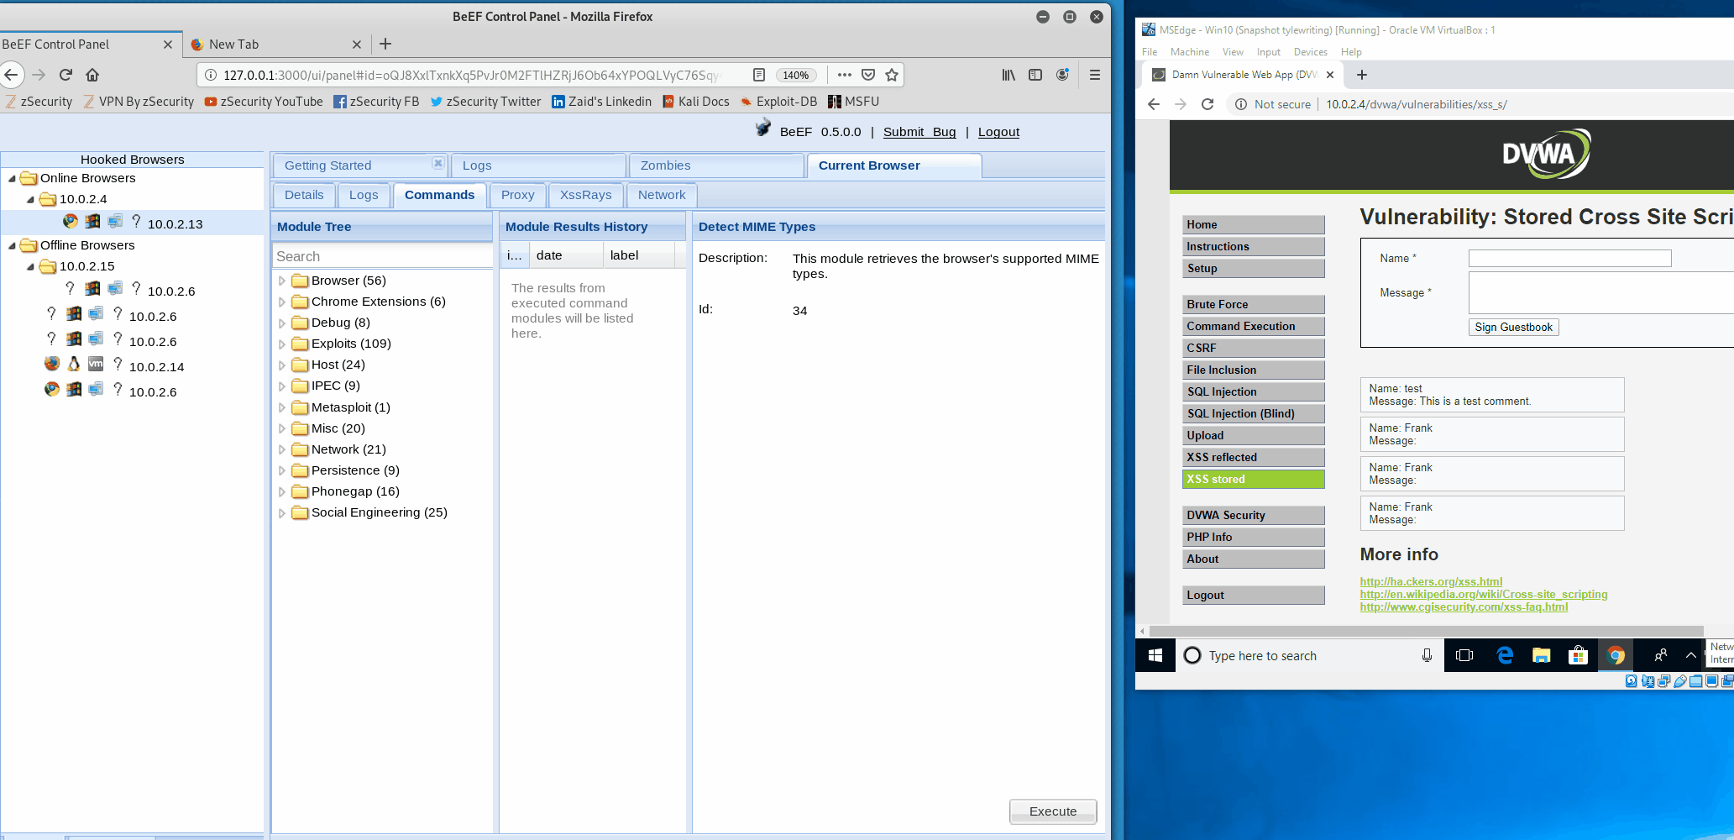
Animation: Take picture of victim’s PC

Slide 23
Your work
Attack mutillidae using XSS
Capture screenshots
Notes:
Blog entry

